Slide 1
Partnerships for Learning
at O.L.D. in 2020
Prep

Slide 2
Prayer
Our Lady of Dolours School Prayer
God our Father
Be with us today
As we are living together
Loving you and each other
And learning in Christ to follow your way
We make this prayer
Through Christ our Lord
Amen

Slide 3
Parents and Teachers
I dreamed I stood in a studio
And watched two sculptors there
The clay they used was a young child’s mind
And they fashioned it with care
One was a teacher, the tools he used
Were books and music and art
One was a parent with a guiding hand
And a gentle loving heart
Day after day the teacher toiled
With a touch that was deft and sure
While the parent labored by his side
And polished and smoothed it o’er
And when at last the time had passed
They were proud of what they had wrought
For the things they had moulded into the child
Could never be sold or bought
And each agrees they would have failed
If they had worked alone
For behind the parents stood the school
And behind the teacher, the home.
Author Unknown

Slide 4
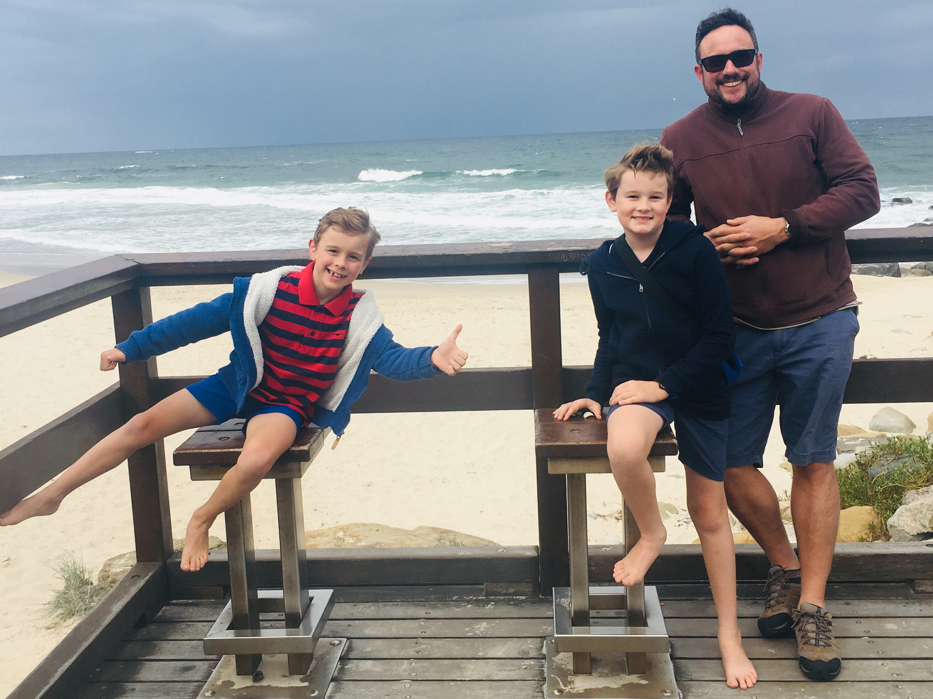
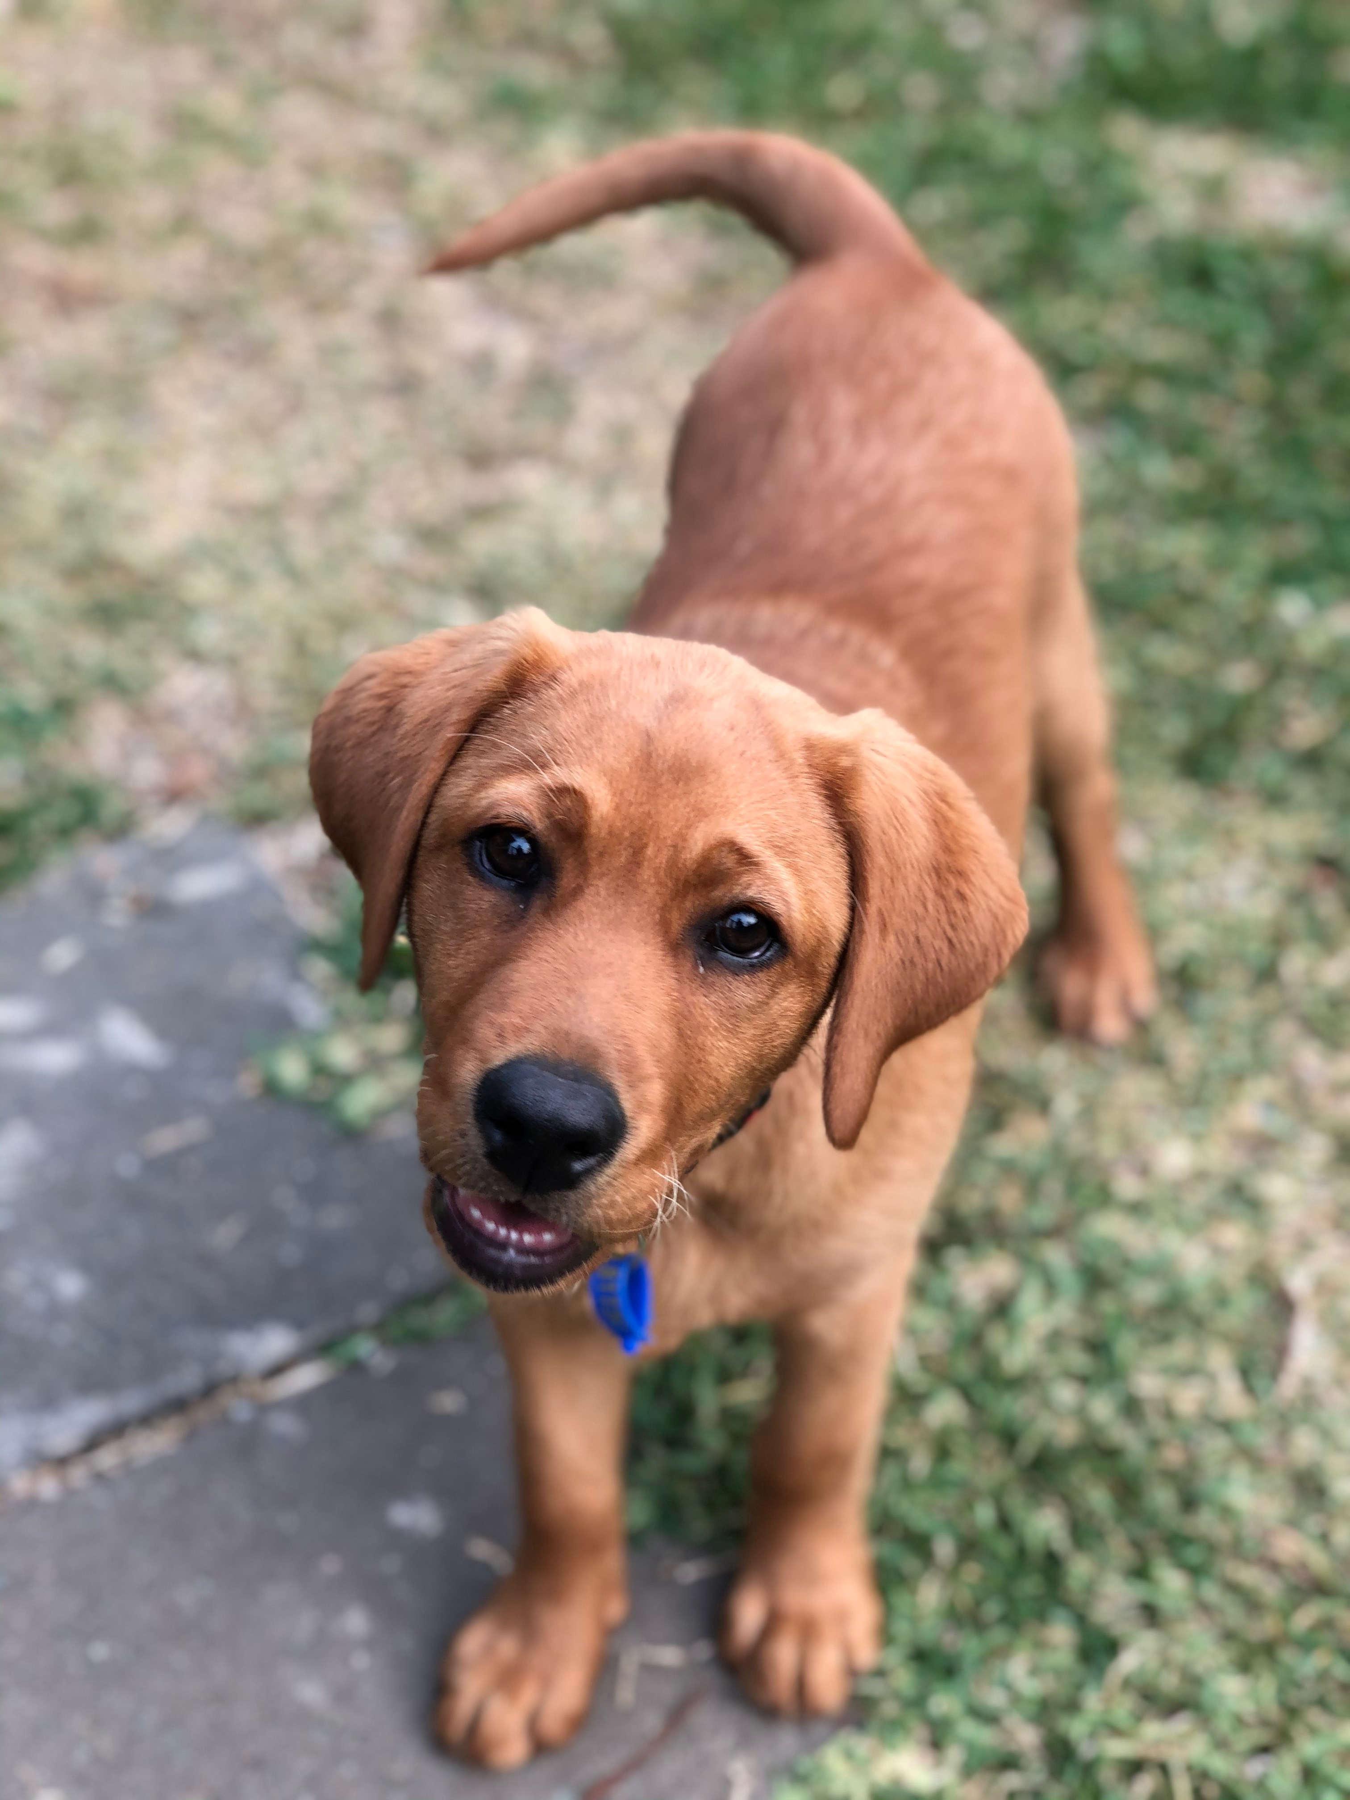
Background
I completed school and decided to travel overseas for 12 months.
I returned to Australia and graduated with my Bachelor of Education in 2003.
I met my husband, who was in the Defence Force which provided me a wealth of experience to teach in many schools in different states and territories.
We both took a year off work and travelled around Australia in 2008.
We have two sons who attend O.L.D. (Yr 5 and Yr 3).
12 months ago my husband transitioned from the army after 22 years, so we are now based in Brisbane – forever!

Slide 5
Teaching Philosophy
Grow and develop - personally, socially, academically and spiritually
Learn the skills to become responsible citizens in a changing world
Develop skills to be reflective about themselves, others and life so that they may have respect, tolerance and love for all people and the world
Establish clear expectations as they are critical in the development of boundaries that support students’ behaviour and learning
Use active learning, hands-on resources, interactive games and craft in meaningful ways to enhance learning
Have enjoyable and interesting learning experiences
Be rewarded for good effort and cooperation
Develop a love of learning so they will be motivated to find out about their world thereby becoming independent life-long learners

Slide 6
EMBRACE THE CHALLENGE IN 2020

Slide 7
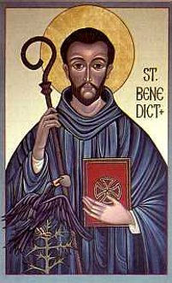
2020 – The Year of St Benedict

Slide 8
Whole School Teaching and Learning Vision
We believe that all students can think, learn, inquire and create
We believe that all students can get along with and care for others
We believe that all students can act so they can make a difference in the world.

Slide 9
Thinking and Learning
Key Learning Areas
OLD follows the national curriculum by ACARA
English, Maths, Science, HASS, The Arts, Technology, Health and Physical Education
OLD follows the BCE Religious Education Curriculum
Language of Learning
Learning Intentions
We Are Learning To…
Success Criteria
What I’m looking for…
Feedback
Teacher given, student reflection, peer feedback
Key Questions:
What are you learning?
How are you going?
How do you know how you’re going?
How can you improve?
What do you do if you need help?
‘Active Learning’

Slide 10
Thinking and Learning
Assessment and Reporting
Portfolios; Report cards; Parent/Teacher Meetings; Informal meetings, Celebration of Learning Events
Supporting Learning
Using a variety of activities and teaching techniques to engage a range of learners
Linda Dwyer is our STIE (Learning Support Coordinator)
Mary-Anne Fogarty is our (PLL) Primary Learning Leader – works with the teachers for planning
Christine McCabe and Ellena Stone are our Enrichment Teacher’s
Ann Denaro is our full-time Prep School Officer
Specialist Areas
Physical Education on Monday’s with Mr Anthony Ebbage
Music on Wednesday’s with Mrs Deanne Johnson
Digital Technology with Mr Terry Madden OR Visual Art with Mrs Therese Flynn-Clark
Japanese on Mondays (teacher yet to be advised)

Slide 11
Thinking and Learning
Homework
Sight Words (from Term 2)
Home Readers (from Term 2)
Show and Tell (favourite book)
Prep Blog

Slide 12
Parent Teacher Communication
All notes to be put in the blue communication folder and placed on the shelf each morning
Term Letters on the blog
Meetings by appointment
Parent/Teacher meetings (beginning of Term 1)
Parent/Teacher interviews (end of Term 1)
Student-Led Conversations in Term 3
Report Cards (Term 2 and 4)

Slide 13
Getting along with and Caring for Others
Student Behaviour Support
Multi tiered approach to School Behaviour Support Model
School
whole class
small group
individual support
The Brisbane Catholic Education Policy
on Behaviour Support is used as a basis to
develop each individual school Student
Behaviour Support Plan.
Our SBS Plan has 3 core expectations:
Strive to Achieve (learning)
Be Respectful (loving)
Act Responsibly (living)
Notes:
Brisbane Catholic Education has a policy on behaviour support which informs the schools policy which in turn is the basis for our class behaviour support model.
In the classroom we have formulated rules together along with our class covenant which is a contract between the class and teachers of what is expected.
Both teachers believe in an emphasis on the positive behaviours rather then a focus on the negative and we reinforce this with rewards and prizes.
My behaviour policy is about relationships, I am certainly not strict by any stretch of the imagination but I talk to the kids about a good working relationship being about understanding where the other person is coming from. So if a student is choosing a behaviour that does not align with our core expectations my first port of call is to have a discussion with them about what is happening.

Slide 14
Getting along with and Caring for Others
Student Behaviour Support
Prep Rewards
Stickers, praise, wrist bands, KIC awards
These may change throughout the year.

Slide 15
Guidance Counselling
Guidance Counsellor, Ruth Blackburn at OLD 2 days per week (Monday’s and Tuesday’s)
Can assist with a range of issues that might impact on learning, including:
Anxiety
Friendship/social skills
Grief and loss
Behavioural concerns
Learning difficulties

Slide 16
Guidance Counselling
Referrals to the Guidance Counsellor can be made through the classroom teacher
Teacher raises referral to the Student Support Team (Principal, Learning Support and Guidance Counsellor)
Parental consent is obtained for GC to be able to provide services

Slide 17
Act to Make a Difference in the World
Effective Habits of Thinking and Doing
The Keys to Success
Organisation
Confidence
Persistence
Resilience
Getting Along
Religious Life of the School
Classroom Prayer
Prayer Assemblies
Social Justice and Action Projects (eg, Caritas, Missions etc)
Responsibilities
Unpacking bag in the morning and packing in the afternoon

Slide 19
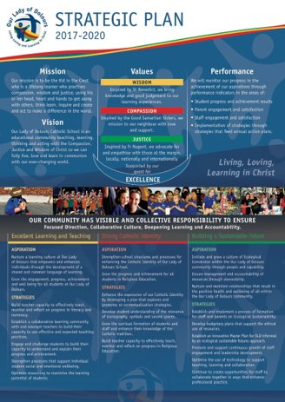

Slide 20
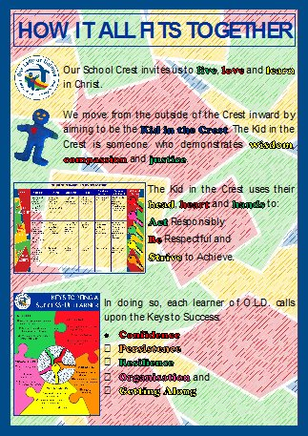

Slide 26
Act to Make a Difference in the World

Slide 27
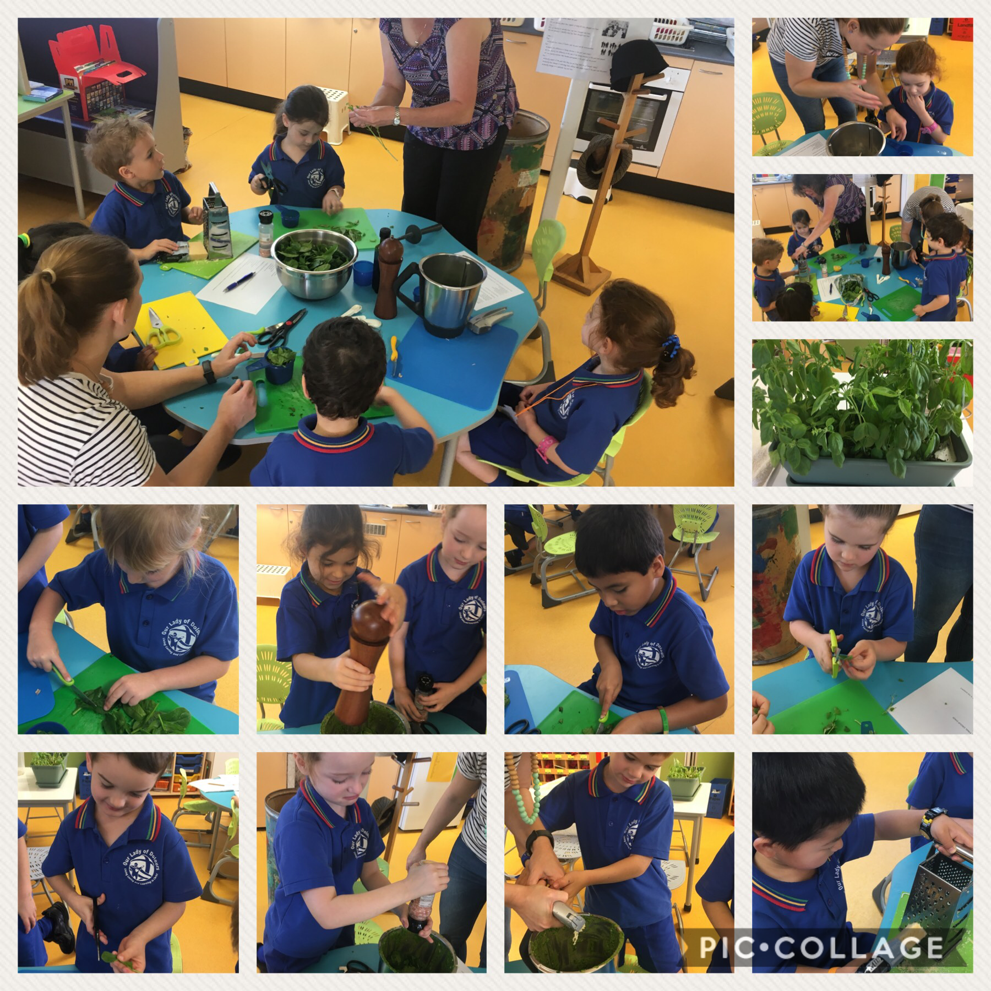
Act to Make a Difference in the World

Slide 28
Pastoral Parent
Leane Middleton (Maeve’s Mum)

Slide 29
Parents and Friends Association
P&F Executive appreciate the support you can offer across the year
All P&F information can be found on the P&F
Working Bee’s occur once a Term

Slide 30
Absences
Absences from school – please email pmit@bne.catholic.edu.au , or rstigter@bne.catholic.edu.au.
SMS notifications will be sent each morning when absence is unexplained.
The importance to notify of student absence.

Slide 31
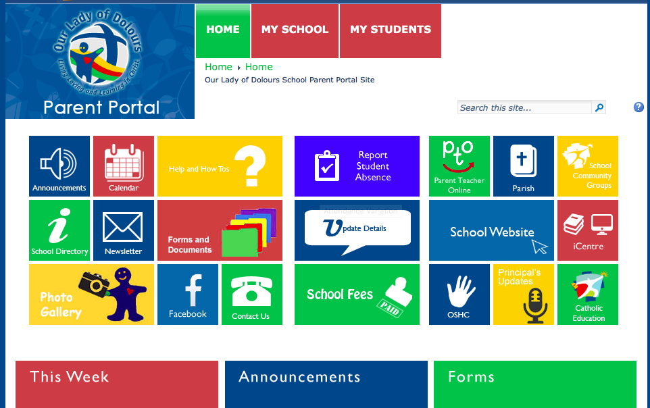
Notes:
Refer to the importance of Parent Portal
This is the main tool of finding out what is happening in the school.
Whilst there are double ups between the school website and Parent Portal, we will mainly direct you to locate informaion on Parent Portal.
In the first instance we will most likely email out information but then store it on the parent portal for your access.
So if ‘you did not get that piece of information’ or ‘you weren’t email it’ then look on the Parent Portal.
It is evolving as we go but most of the tiles now have information on them

Slide 32
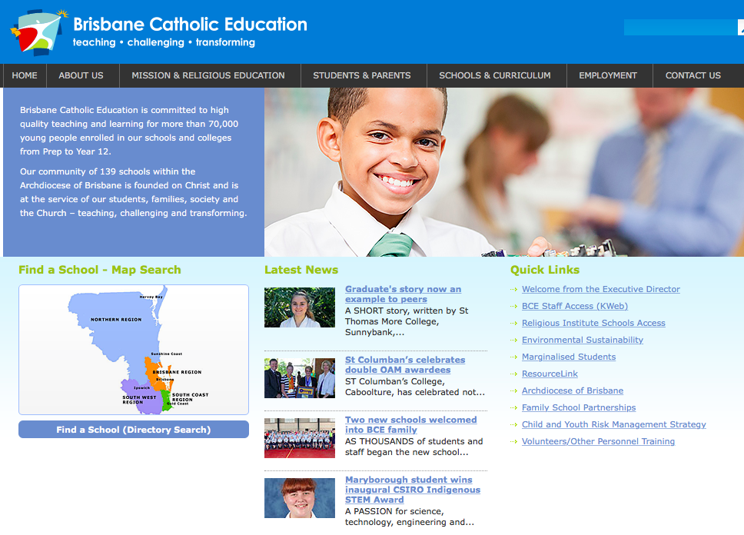
Parent Helper Volunteer Training

Slide 33
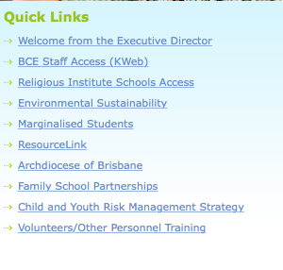
Volunteer Training

Slide 34
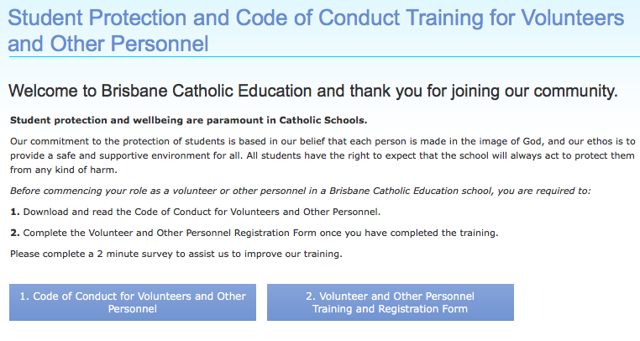
Volunteer Training

Slide 35
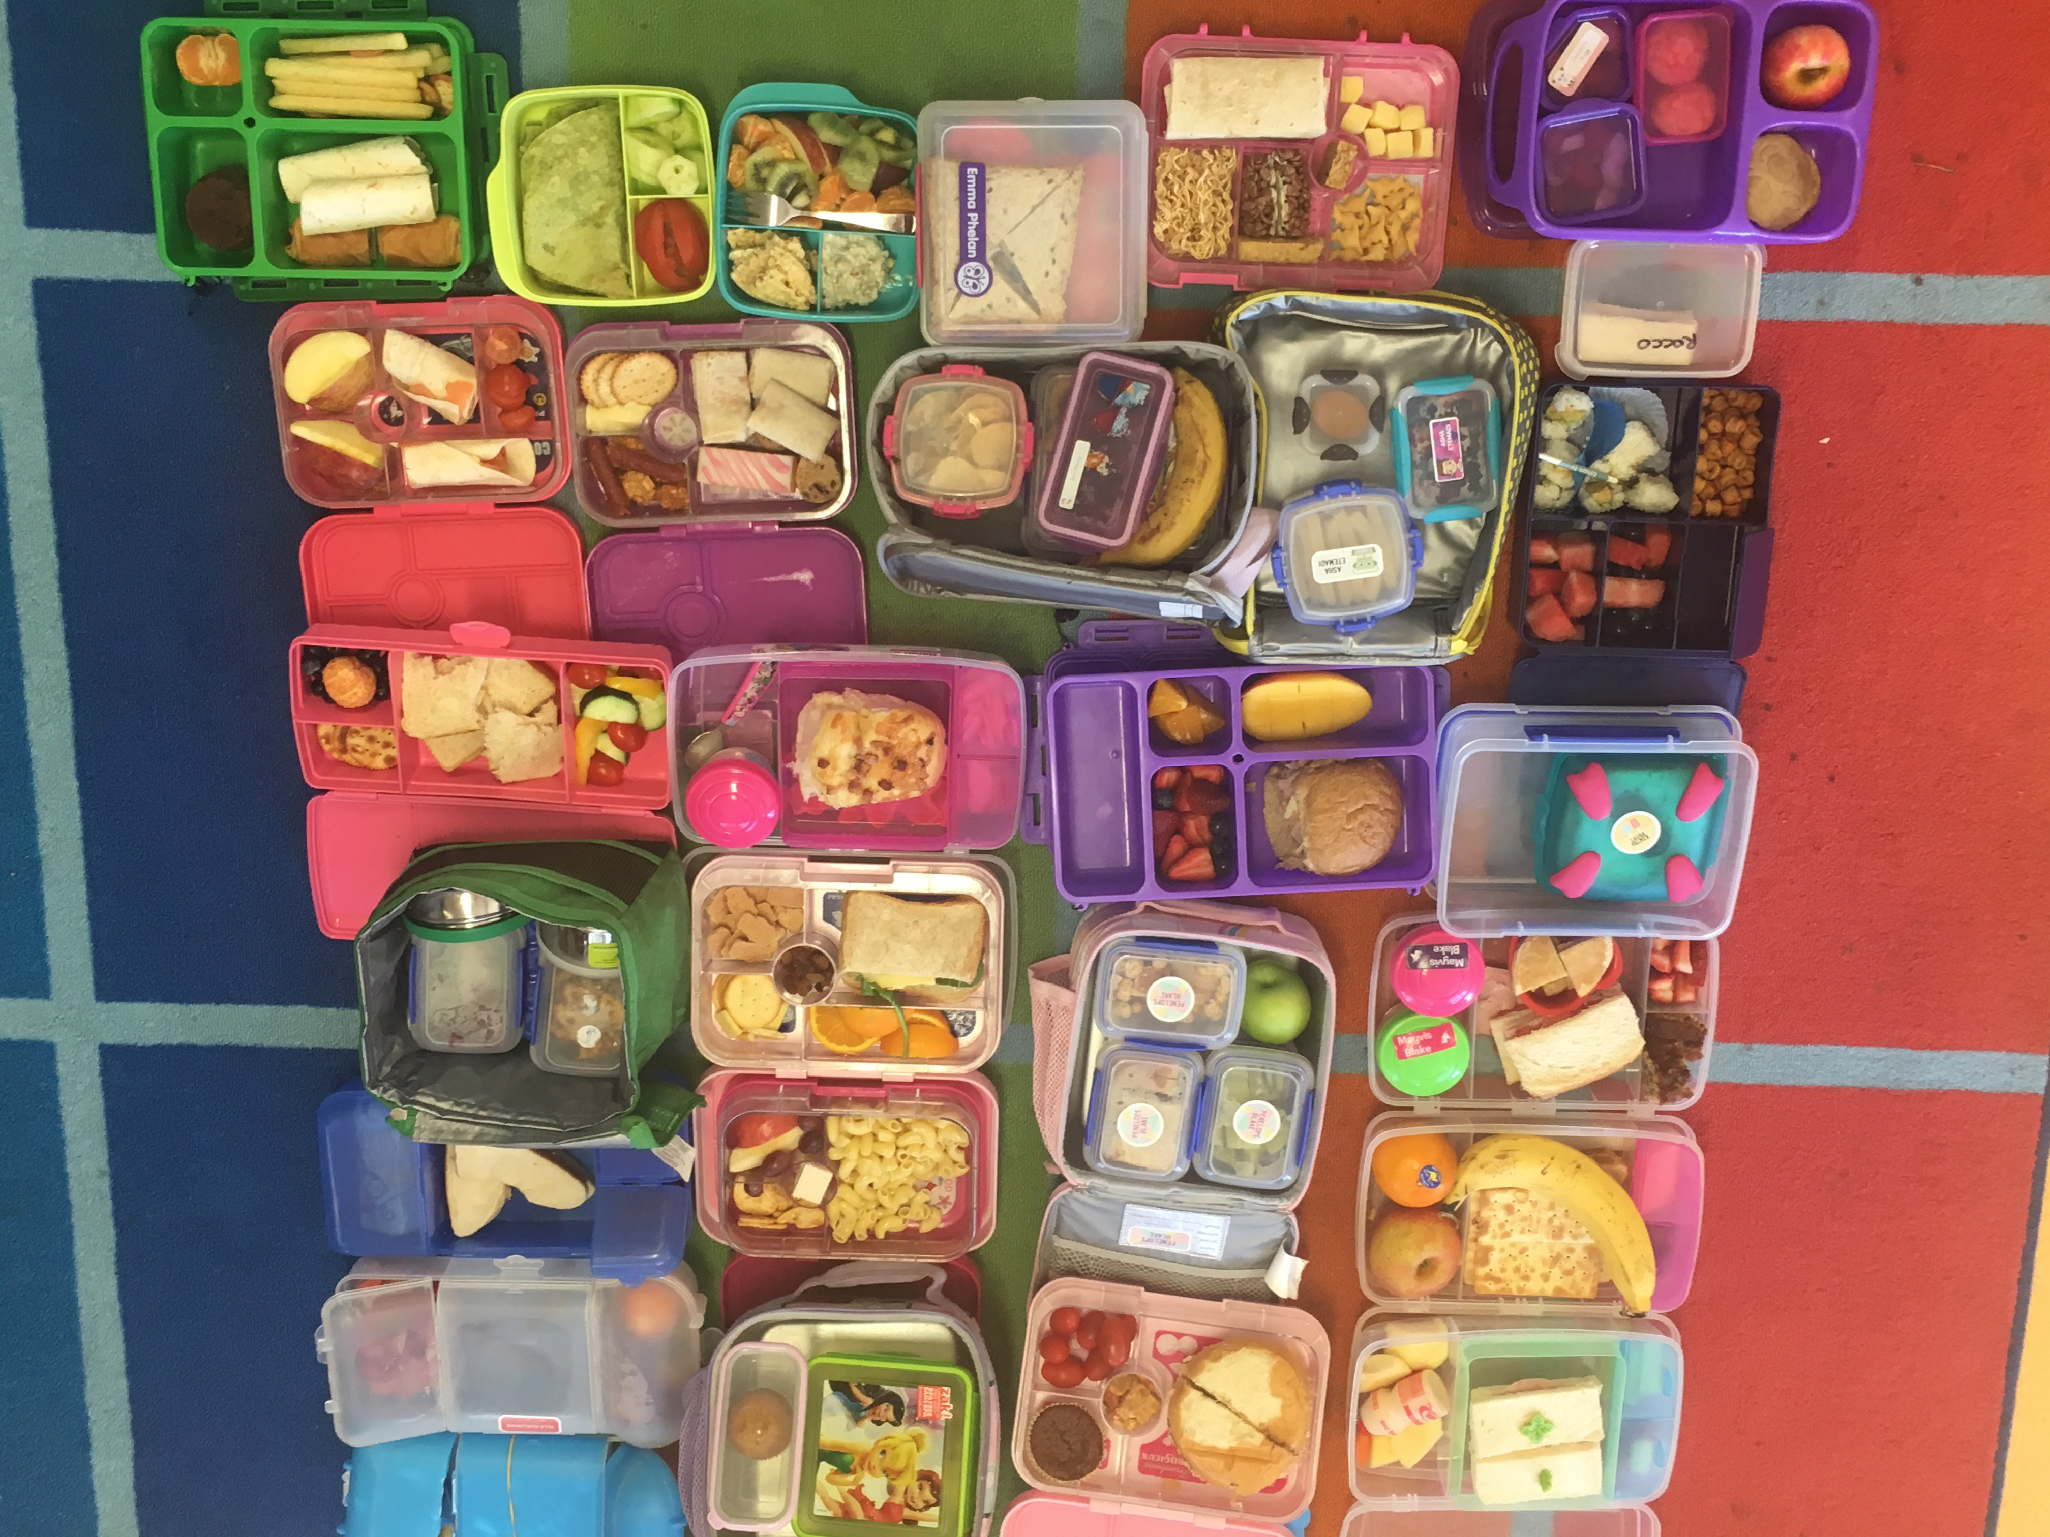
Miscellaneous Matters
Celebration of student birthdays – cupcakes or ice blocks
Snacks and Lunches
‘Nude Food’

Slide 36
Miscellaneous Matters
Library day is Friday – borrowing and Reading Eggs
Opening school mass – 14th February at 9am
Class covenant presentation
Water Play Day – Monday 2nd March
LENT (Ash Wednesday Liturgy 26th February)
Project Compassion
Notes:
Remember allergy with cakes etc

Slide 37
Important Information
School Pick-Up
Please refrain from parking in the Loading Zone on Suez Street. It causes major congestion.
OSHC
If your arrangements change please notify OSHC AND myself or the school.

Slide 38
Things we need from you ☺
Donations Please!
recycled items to plant in (old pots would be perfect or feel free to bring in a plant for our garden and decorate the pot or label it with your child’s name
shoe boxes of any size
Please bring in:
your child’s favourite book ( label so we can return it)
large old shirt for art in Term 2 (e.g. adults old shirt)
library bag (named) -children must have a library bag to borrow a book.
roll on sunscreen to store in hat box

Slide 39
Questions?

